Slide 1
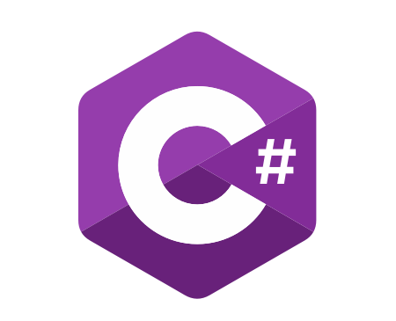
C# Advanced
Course Introduction
SoftUni Team
Technical Trainers
Software University
https://softuni.bg/

Slide 2
Table of Contents
Course Objectives
Training and Team
Course Organization
Course Infrastructure
Evaluation Criteria

Slide 3
Have a Question?
sli.do
#fund-csharp

Slide 4

Course Objectives

Slide 5
C# Fundamentals Module Goals
Work with advanced data structures
Read and write files
Defining classes and using objects
Build class hierarchy
Apply principles and good practices for building quality software

Slide 6
Practical Programming Exam
4 practical problems for 6 hours
Stacks and Queues
Multidimensional Arrays
Regex and String Processing
Dictionaries
Automated judge system
http://judge.softuni.bg
Solutions are evaluated for correctness only
Code quality is still not measured

Slide 7

Exam Demonstration

Slide 8

The Team

Slide 9
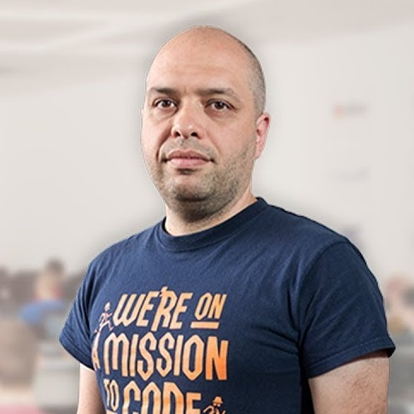

Stamo Petkov
Head Of Department at Information Services Plc.
Worked with various technologies
.NET and C#, BASIC, Pascal, Object Pascal, PHP
More than 15 years of experience
Experienced Lecturer
C# Basics and ASP.NET MVC @ Softuni

Slide 10
INFORMATION SERVICES
Key partner of the state institutions in the implementation of ICT projects
The Ministry of Finance
The National Revenue Agency
The Customs Agency
The Ministry of Regional Development and Public Works
The first governmentally approved provider of qualified certification services in Bulgaria
https://www.is-bg.net/bg/

Slide 11
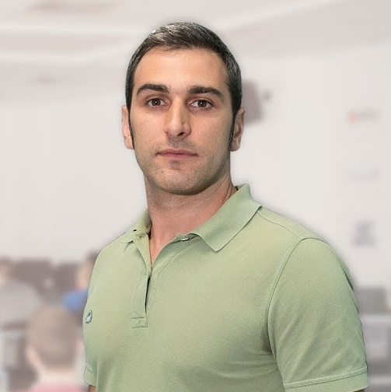

Radi Atanasov
Chief SharePoint Architect, Owner @ OneBit Software
Achieved two of highest degrees of technologie certification
Microsoft Certified Master
Microsoft Certified Solution Master
External consultant at "Office 365 Developer Patterns & Practices Core Team" at Microsoft Redmond

Slide 12
ONEBIT SOFTWARE
Software development and consulting company
Heavy involvement with the Microsoft SharePoint platform
Winning and delivering some of the best SharePoint projects
OneBit Survey Master
OneBit Quick Poll
https://www.onebitsoftware.net/

Slide 13
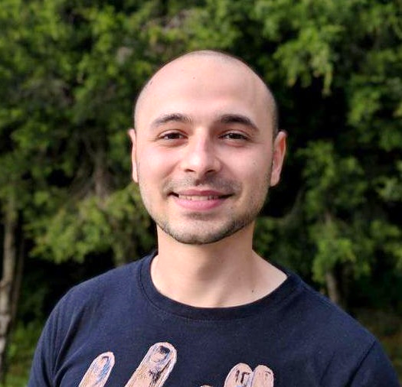
Stoyan Shopov
Technical Trainer @ SoftUni
ASP.NET Web Developer
Experience with MSSQL and ADO.NET
Interested in self-development and business
Mountain lover

Slide 14

Course Organization

Slide 15
C# Fundamentals Module – Timeline
17-Sept-2018
15-Oct-2018
19-Nov-2018
C# Advanced
4 weeks * 4 times / week
6 credits
Start: 17-Sept-2018
Final exam: 14-Oct-2018
OOP Basics
5 weeks * 4 times / week
9 credits
Start: 15-Oct-2018
Final exam: 18-Nov-2018
OOP Advanced
4 weeks * 4 times / week
12 credits
Start: 19-Nov-2018
Final exam: 16-Dec-2018
Re-Take Exams
TBA

Slide 16

Homework Assignments & Exercises
Your homework is mainly work in class
Lesson days → slides + live demos + exercises
Exercise days → only exercises
How to submit your homework?
Submitted in the judge system
Do your homework when it's due
Assignments pile up quickly

Slide 17


Scoring System for the Course
Mandatory:
Final exam – 85%
Exercises & homework – 15%
Bonuses:
Presence in class – 5% bonus
Forum activity – bonus up to 5%

Slide 18



Course Web Site, Forum and FB Group
Official web site:
Official discussion forum:
Official Facebook group:
https://softuni.bg/courses/csharp-advanced/
softuni.bg/forum/categories/30/
http://fb.com/groups/ SoftUniCsharpFundamentalsSeptember2018

Slide 19


The Free C# Fundamentals Textbook
The official textbook for the course
"Fundamentals of Computer Programming with C#", by Svetlin Nakov & Co., 2013, ISBN 9789544007737
English and Bulgarian versions (as PDF, ePub, …)
Freely downloadable from: www.introprogramming.info
The C# Programming courses @SoftUni.bg partially follows the book

Slide 20
https://softuni.bg/courses/programming-fundamentals

Slide 21













SoftUni Diamond Partners

Slide 22




SoftUni Organizational Partners

Slide 23




Trainings @ Software University (SoftUni)
Software University – High-Quality Education and Employment Opportunities
softuni.bg
Software University Foundation
http://softuni.foundation/
Software University @ Facebook
facebook.com/SoftwareUniversity
Software University Forums
forum.softuni.bg

Slide 24

License
This course (slides, examples, demos, videos, homework, etc.) is licensed under the "Creative Commons Attribution-NonCommercial-ShareAlike 4.0 International" license

